Slide 1
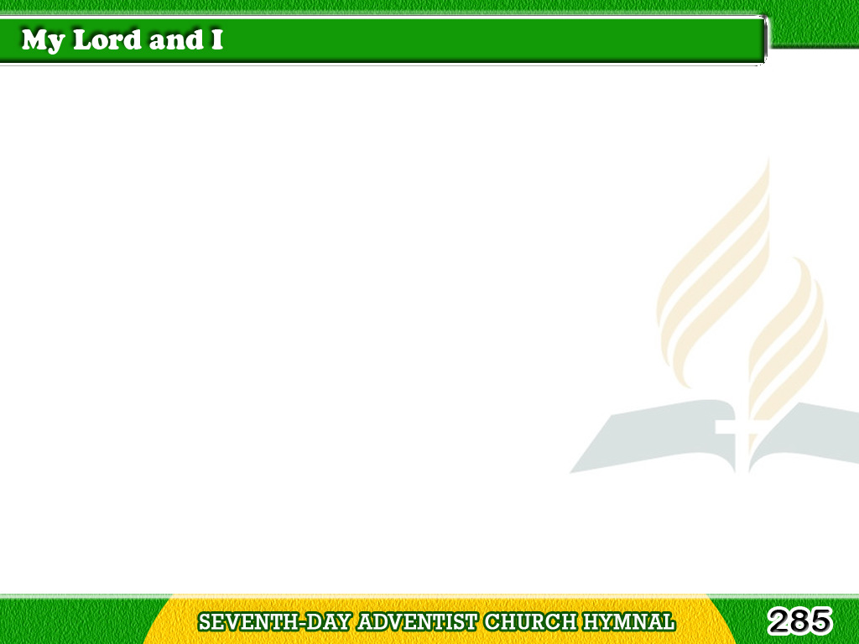
1/4
I have a Friend so precious,
So very dear to me,
He loves me with
such tender love,
He loves so faithfully;
Tagalog
Version

Slide 2
1/4
I could not live apart from Him,
I love to feel Him nigh,
And so we dwell together,
My Lord and I.
Tagalog
Version

Slide 3
2/4
Sometimes I’m faint and weary,
He knows that I am weak,
And as He bids me lean on Him,
His help I gladly seek;
Tagalog
Version

Slide 4
2/4
He leads me in the paths of light,
Beneath a sunny sky,
And so we walk together,
My Lord and I.
Tagalog
Version

Slide 5
3/4
I tell Him all my sorrows,
I tell Him all my joys,
I tell Him all that pleases me,
I tell Him what annoys;
Tagalog
Version

Slide 6
3/4
He tells me what I ought to do,
He tells me how to try
And so we talk together,
My Lord and I.
Tagalog
Version

Slide 7
4/4
He knows that I am longing
Some weary soul to win,
And so He bids me go and speak
The loving word for Him;
Tagalog
Version

Slide 8
4/4
He bids me tell
His wondrous love,
And why He came to die,
And so we work together,
My Lord and I.
Tagalog
Version

